Slide 1
FutureFlix: The Future We Choose
Teachers’ meeting
22 September 2026

Slide 2
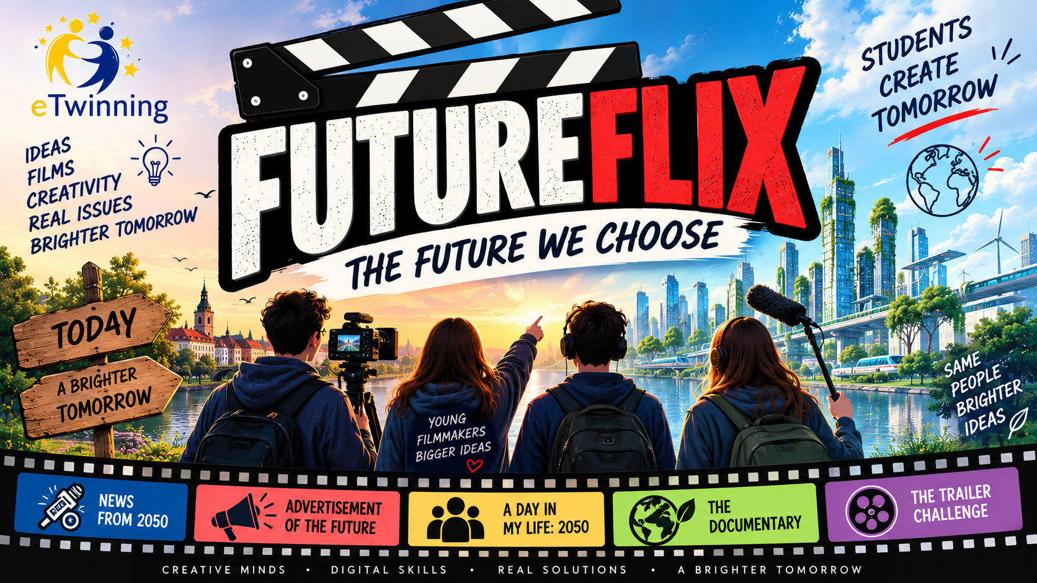
About project
Croatia, Slovakia, Poland and Türkiye
Age of students: 11–14 years
Duration: October 2026 – April 2027

Slide 3
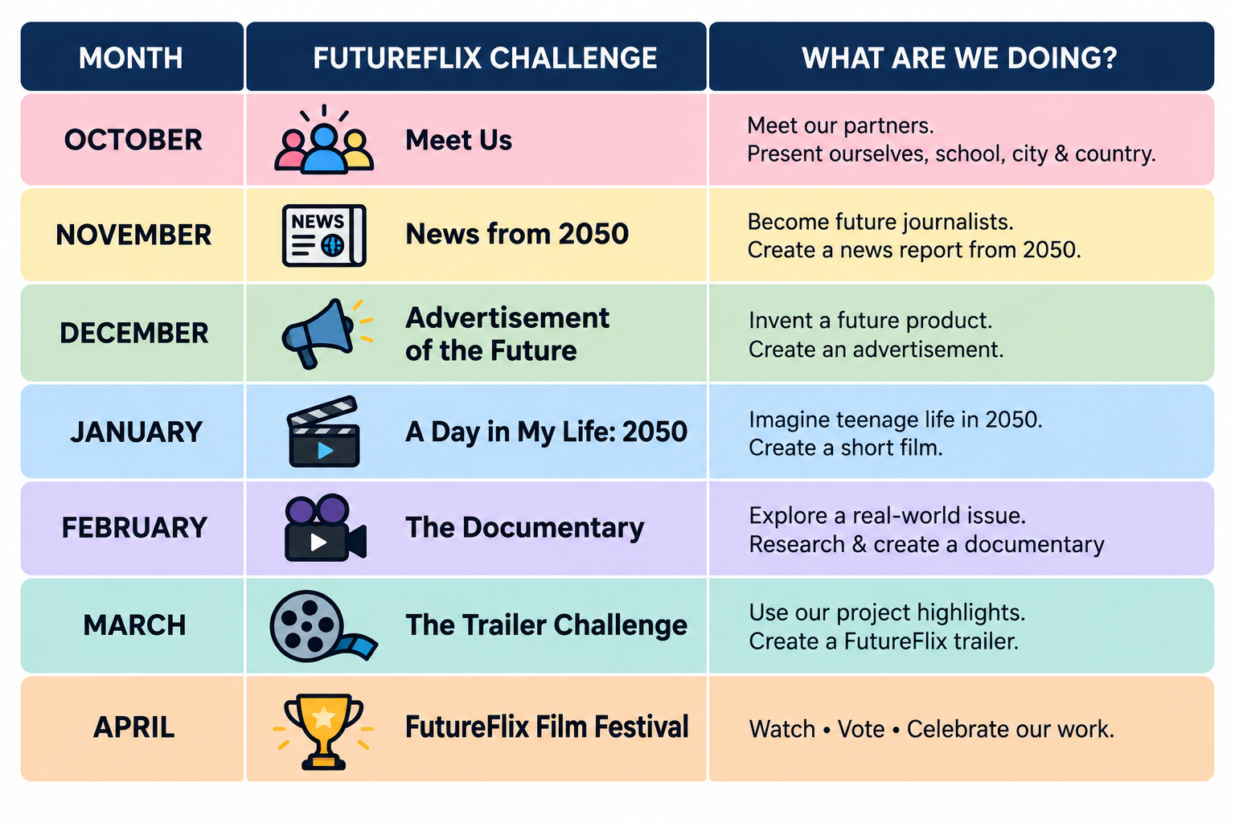
Project timeline

Slide 4
October – Meet Us
Step 1 – Meet Us
Create one presentation introducing your school, city/town and country.
Introduce the students participating in FutureFlix through a short video or another creative format.
Step 2 – Partner City in 2050
Explore the presentations created by the partner schools.
Each school will be assigned one partner city/country (Croatia and Poland / Türkiye and Slovakia).
Imagine what that city/country could look like in 2050.
Create a short presentation or visual showing your vision of the partner city in 2050.
Share your vision with the partner school.
Suggested tools: Canva • PowerPoint • Genially • Padlet • CapCut

Slide 5
Padlet for October
https://padlet.com/kristina_katusic1/futureflix-the-future-we-choose-v85nlh0cyfzfpxb

Slide 6
November – News from 2050
Imagine you are a news reporter in the year 2050.
Explore one of our main topics: Digital Life (Türkiye), Transport (Slovakia), Climate (Poland) or Food (Croatia).
Think about how today's situation could change by 2050.
Write a short news script and decide who will be reporters, guests or experts.
Record and edit your News from 2050 report.
Be creative – your future can be positive, negative, funny or surprising.
Suggested tools:
Canva • CapCut • Clipchamp

Slide 7
December – Advertisement of the future
Invent it. Create it. Sell it!
Invent a product or service from 2050 – give it a name and slogan.
Create a prototype or model using cardboard, recycled materials, LEGO, etc. It doesn’t have to work! You can also create a digital design.
Design a logo and decide what your product will look like.
Create a short video advertisement and convince your audience they need your product!
Suggested tools & materials:
Cardboard • recycled materials • Canva • AI image tools • CapCut / other video editors

Slide 8
January - A day in my life: 2050
Create a story about one ordinary day in 2050.
Think about school, home, transport, food, communication, technology and free time.
Decide what has changed – and what has stayed the same.
Create characters and write a short script.
Divide the roles: actors, director, camera, sound, editing...
Record and edit your short FutureFlix film (3 min max).
Suggested tools:
CapCut • Clipchamp • Canva • smartphones/tablets • green screen

Slide 9
February – The documentary
Each school explores one topic: Digital Life, Transport, Climate or Food.
Explore the situation today – What is happening? What are the main problems or challenges?
Collect information – conduct a short survey and use reliable facts or statistics.
Hear different voices – interview students, teachers, parents or other people.
Show real-life examples – use photos or video clips from your school, town or community.
Present your findings – What did you discover? What do the results show?
Suggest solutions – What could we change or improve today?
Look towards 2050 – How could these changes create a better future? What would you like this area of life to look like in 2050?
Put everything together into a short 5–10 minute documentary.
Suggested tools:
Forms • Canva • CapCut • interviews • surveys • photos & videos

Slide 10
March - The trailer challenge
Turn FutureFlix into a movie!
Look back at everything we created during the project.
Choose the best, funniest or most interesting moments.
Decide what message your trailer should send.
Combine short video clips, images, text and music.
Create a 30–60 second FutureFlix trailer.
Make your audience curious – don't show them everything!
Suggested tools:
CapCut • Canva • Clipchamp • Adobe Express

Slide 11
April - Futureflix international film festival
Watch creations from all four partner countries.
Take part in our International FutureFlix Film Festival.
Give feedback to students from partner schools.
Vote for your favourite productions in different categories.
Celebrate the most creative stories, performances, ideas and solutions.
Reflect on the project: What did we learn? What did we enjoy? What would we change?
Suggested tools:
TwinSpace • Forms • Padlet • Canva
Possible award categories
Best Film • Best Story • Most Creative Idea • Best Future Solution • Funniest Film • Best Performance • Best Trailer

Slide 12
International student collaboration
Comment & React – After each monthly challenge, students watch or explore the work of another partner school and leave a comment, question or feedback on TwinSpac, Padlet etc.
Ask Our Partners – Each school prepares 2–3 questions for another country connected to the monthly topic. Partner students answer them through TwinSpace or a short video.

Slide 13
International Survey – Each school creates a short survey (5–8 questions) connected to its documentary topic. Students from all four partner countries complete the survey. Each school analyses and compares the results and includes the most interesting findings in its documentary.
FutureFlix Festival – At the end, students watch productions from other countries and vote, comment and choose awards.

